Slide 1
Topic: Furniture Store Information Management System
Group 13: Đoàn Đình Nam Ba9-045
Nguyễn Thị Nhàn Ba9-049
Phạm Lê Thùy Linh Ba9-033

Slide 2
INTRODUCTION

Slide 3
STUCTURE
py classes
Modules
Packages

Slide 4
1. py classes

Slide 5
Class Bill():
def GenerateBill():
connectObj = db.connect("FurnitureStoreManagement.db")
cur = connectObj.cursor()
global billarea
if p1quantity.get() == 0 and p2quantity.get() == 0 and p3quantity.get() == 0 and p4quantity.get() == 0:
messagebox.showerror("Error", "No product purchased")
else:
billarea.delete('1.0', END)
billarea.insert(END, "\t|| Furniture Store Management System ||")
billarea.insert(END, "\n_________________________________________\n")
billarea.insert(END, "\nDate\t Products\tPrice\t QTY\t Total")
billarea.insert(END, "\n==========================================")
price = IntVar()
price2 = IntVar()
price3 = IntVar()
price4 = IntVar()
print(dateE.get())
price = price2 = price3 = price4 = 0
(...)

Slide 6
Class view():
def view():
connectObj = db.connect("FurnitureStoreManagement.db")
cur = connectObj.cursor()
sql = 'Select * from Sellings'
cur.execute(sql)
rows = cur.fetchall()
viewarea.insert(END, f"Date\t Product\t Price of 1\t Quantity\t Price\n")
for i in rows:
allrows = ""
for j in i:
allrows += str(j) + '\t'
allrows += '\n'
viewarea.insert(END, allrows)
(...)

Slide 7
Class AddStock():
def addStock():
global dateE2, qty, name, price
connectObj = db.connect("FurnitureStoreManagement.db")
cur = connectObj.cursor()
sql = '''
INSERT INTO stocks VALUES
(?, ?, ?, ?)
'''
cur.execute(sql, (dateE2.get(), name.get(), price.get(), qty.get()))
connectObj.commit()
(...)

Slide 8
Class ViewStock():
def viewStock():
connectObj = db.connect("FurnitureStoreManagement.db")
cur = connectObj.cursor()
sql = 'Select * from stocks'
cur.execute(sql)
rows = cur.fetchall()
viewarea2.insert(END, f"Date \tProduct\t Price\t Quantity\t \n")
for i in rows:
allrows = ""
for j in i:
allrows += str(j) + '\t'
allrows += '\n'
viewarea2.insert(END, allrows)

Slide 9
2. Modules
from tkcalendar import DateEntry
import sqlite3 as db
def connection()
def GenerateBill()
def view()
def connection2()
def addStock()
def viewStock()

Slide 10
3. Packages
FurnitureStoreManagement.db
tkinter
db.connect

Slide 11
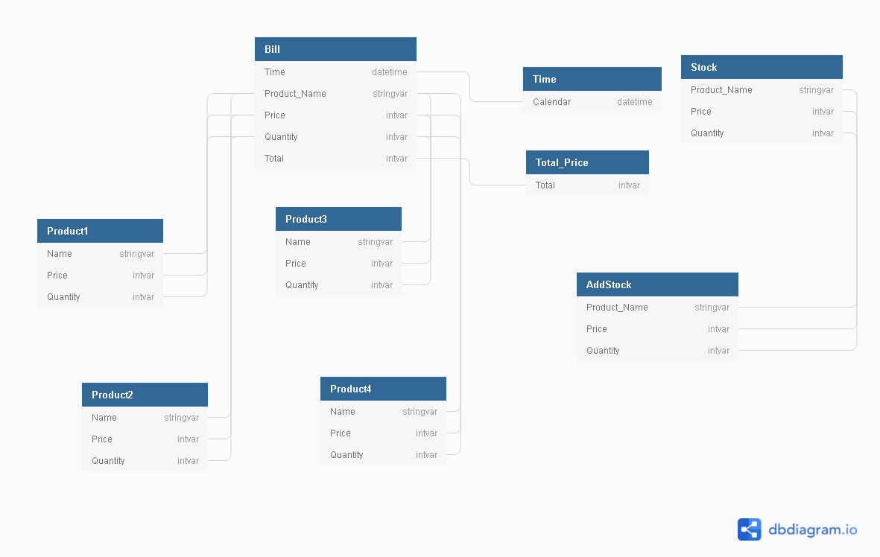
DATABASE DIAGRAM

Slide 12
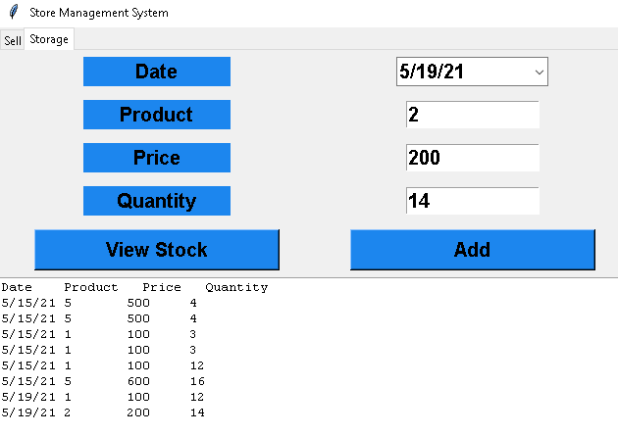
DEMO

Slide 13
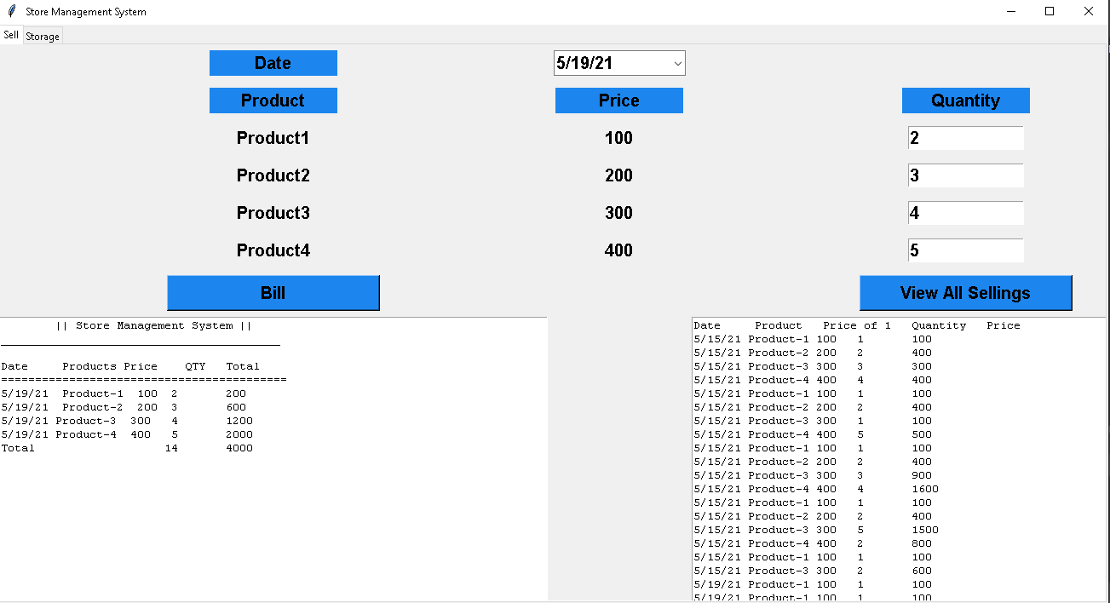
DEMO

Slide 14
CONCLUSION

Slide 15
We hope to be able to create the system:
Manage the number of products (number of products imported and sold during the day).
Manage revenue and expenditure.
Give the amount of profit for the day.
The system can store data about customers.

Slide 16
Done
-Manage the number of products (number of products imported and sold during the day).
Manage revenue and expenditure.

Slide 17
...Not Done
Give the amount of profit for the day.
The system can store data about customers.

